Slide 1
Cooperation and Compatibility
Byung Joon Yoo

Slide 2
How Standards Change the Game
Alone, Allies or Open? Coopetition (Ally to form a network and compete in the network- ‘Collaborate to compete’)?
Expanded network externalities
  Make network larger, increase value
    Share info with larger network
    Attracts more users
Reduced uncertainty
  No need to wait
  In war, neither side may win (when older technology available – 56k modem, AM stereo)

Slide 3
Change Game, cont’d.
Reduced consumer lock-in
  Netscape’s “Open Standards Guarantee”
  Companies may not like standard in their mind even though they participate in (Different Extent..)
Competition for the market v. competition in the market
  Buy into an open standard, that becomes closed? (Collectively locked in)
  Motorola, DJIA (Dow Jones Industrial Avg)

Slide 4
Change Game, cont’d.
Competition on price vs. features
  Compatibility and network effect (price war) vs. Differentiation
  Suppliers - Induce partial incompatibility and get smaller market vs. Buyers
Competition to offer proprietary extensions
  But kept by an owner of the proprietary rights (Sony & Philips, Intel)
Component vs. systems competition
  With interconnection, can compete on components (HP-Printer, Sony-Monitors)
  Generalists – Thrive at the absence of compatibility

Slide 5
Who Wins and Who Loses?
Consumers
  Generally better off – No Lock-in
  But variety may decrease
Complementors
  Generally better off
  DVD
    Good for Movie Studios
    Bad for VCR players (Substitute)
    Blockbuster Video Rental - Good & Bad

Slide 6
Who Wins, cont’d.
Incumbents
  May be a threat
  Strategies
    Deny backward compatibility – To block Entry
    Introduce its own, different standard – To win Standard war
    Ally itself with new technology – e.g. Sony & Philips CD to DVD (Sabotage may be a better way – e.g. MS for JAVA)

Slide 7
Who Wins, cont’d.
Innovators
  Technology innovators collectively welcome standards
  If the group benefits from NE, there should be some way to make members benefit
  Opportunistic behavior – Small players (free ride)

Slide 8
Formal Standard Setting
Essential patents must be licensed on “fair, reasonable and non-discriminatory” terms
ITU
  now UN agency
  Notoriously slow – Need for consensus
ANSI and ISO
  11,500 standards
ACM’s SIGs – For voluntary standards

Slide 9
Tactics in
Formal Standard Setting
First: Set what your goal is!
  National or international?
  Protecting your interests? (want this standard set or interrupted?)
What are others goals?
  Do they really want a standard? (should see what is better for them and their real intention)

Slide 10
List of Tactics
Don’t automatically participate
  If you have to give license (e.g. Motorola)
Keep up momentum
  Continue R&D while negotiating (e.g. CBS’ Color TV delay)
Look for logrolling
  Trading technologies and votes

Slide 11
List of Tactics, cont’d.
Be creative about deals (Use it when you can make pivotal difference)
  Licensing, hybrid standard, etc.
Beware of vague promises
  Definition of ‘reasonable’ (Price at the open base)
Search carefully for blocking patents
  Patents held by non-participants (Try to check)
Preemptively build installed base
  Risky but try even before standard set (ITU vs. US Robotics/3Com, Rockwell/Lucent for 56k Modem)

Slide 12
Building Alliances
Assembling allies
  Mind still your advantage! (Tech Know-how is still advantage)
  Pivotal customers should get special deals
  But don’t give your first customers too big an advantage
    Offer temporary price break

Slide 13
Building Alliances, cont’d.
Who bears risk of failure?
  Usually ends up with large firms
  But bankruptcy favors small firms then..
  Government is even better!
    Smart cards in Europe (Risk converted to Commitment)

Slide 14
Interconnection Among Allies
History of interconnetion of adjacent networks
  Post office, telephone, Internet
  Apple, Sony Beta Video <- Backfired by open
Negotiating a truce before standard war
  Do the benefit cost calculation (maximize return not control)
  How to divide a larger pie?

Slide 15
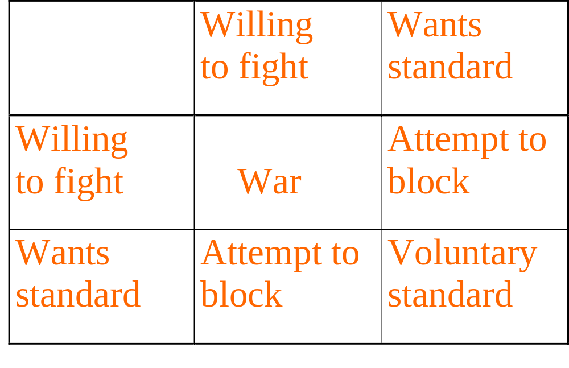
The standards game
Player B
Player
A

Slide 16
Maximizing Return
Your reward = Total value added x your share
Cooperation between Netscape and Microsoft
  Open Profiling Standard (OPS) by Netscape for e-transaction to eliminate privacy problem
  VRML (virtual reality modeling language)
  SET (secure electronic transaction standard)

Slide 17
Alliance Examples
Xerox and Ethernet
  By Metcalfe from Xerox
  Digital (first client) -> Try new one
  Finally standard set
  Could win IBM’s trial of Token Ring
Adobe PostScript vs. Xerox’ Interleaf
Active X (program communication)
  Delegate techs to Open Group even to compete with CORBA

Slide 18
Managing Open Standards
Standard is in danger if it lacks a sponsor (like Open source SW)
Unix
  AT&T invention by accident
  Gave away source code to EDU (researchers)
  1993 Coalition: Novell purchased rights for $320 million and gave name to X/Open standard (free as far as they keep this)
SGML and XML – Not take off, so many dialects
HDTV’s grand alliance – Shaky because of different interests of parties (broadcasting vs. manufacturers)

Slide 19
Lessons
Competition requires allies – Collaborate to compete
How does your standard affect competition? (Different parties)
Standards benefit consumers and suppliers, at expense of incumbents and sellers
Formal standard setting adds credibility
Find natural allies (encourage early supporters)

Slide 20
Lessons, continued
Before a battle, try to negotiate a truce (eliminate rivals)
Try to retain control over technology, even when establishing an open standard (To guide evolution)

Slide 21
Standards Wars
Week 9
Byung Joon Yoo

Slide 22
Examples
Rail Road gauges(4’81/2” vs. 5’)
Edison vs. Westinghouse (Direct Current vs. Alternating Current)
NBC vs. CBS in color TV
3Com vs. Rockwell/Lucent (56k Modem)

Slide 23
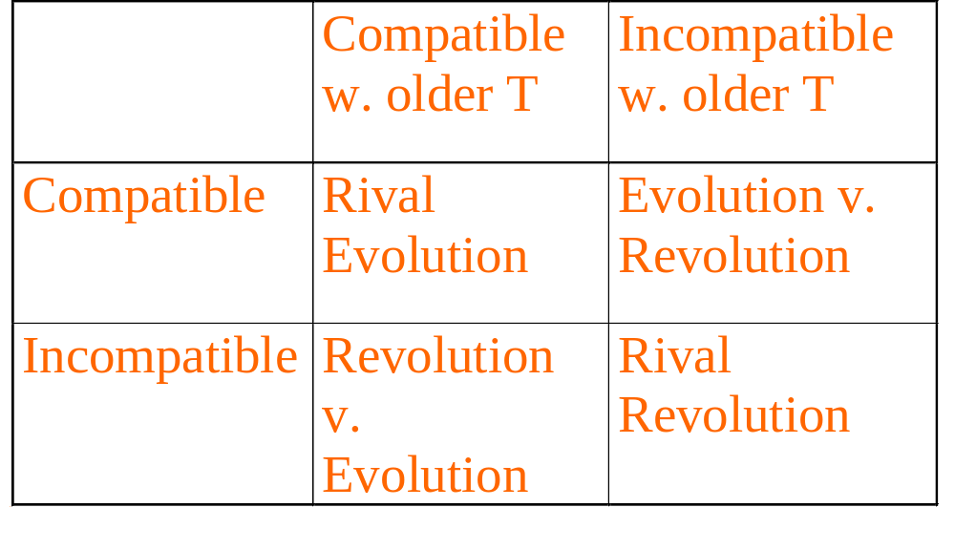
Classification of Wars

Slide 24
Examples
Rival evolution
  56k modem (w. 28k)
Rival revolutions
  Video players, AC vs. DC, High density disks (JAZ, etc.)
Evolution vs. Revolution
  Lotus 1-2-3 vs. Excel
  dBase IV vs. Paradox

Slide 25
Recent Standards Wars
AM stereo (Mutually destructive)
  Auto industry (GM) invested, radio didn’t
  5 Players, Failure with uncertainty and insufficient network effect
Digital wireless phones (Incompatible still)
  Europe: GSM (Global system for mobile comm)
  US: GSM, TDMA (cousin of GSM), CDMA
    TDMA: 5 million
    CDMA: 2.5 million
    GSM: 1 million in 1997 (vs. 50 million analog)

Slide 26
Standards Wars
Ericsson (TDMA) has AT&T, SBC , Bellsouth
Qualcom (CDMA) has Bell Atlantic, US West, Airtouch, Nynex
  Performance play strategy
How big are the network externalities?
  Geographic scope – Local, Long distance different
  Not much because: Investment is sunk, systems interconnected
  Only Lock-in is the handheld device <- Subsidy
  Not winner-take-all market
  Decentralized, market-oriented approach (US) slower but more chances to small players

Slide 27
Standards Wars, cont’d.
56K modems
  US Robotics (3com) x2 attempted preemption over 28.8k(V.34 ITU standard)
  Rockwell/Lucent K56 Flex
  Expectations management, switching costs
  Problems in 97: x2 for ISP, Rockwell for household (No benefit of 56k!)
  Settled Dec 97 (ITU V.90): estimated will triple size of market (Win-Win 10M->33M in 1998)

Slide 28
Key Assets
Control over an installed base (MS)
Intellectual property rights (patent, copyrights)
Ability to innovate (HP engineering skills easy to catch up)
First-mover advantages
Manufacturing (Scale economics – Dell)
Strength in complements (Additional benefit)
Reputation and brand name (Consumers also)
->Make firms to win at war or to be at more advantageous position in setting standard

Slide 29
Two Basic Tactics
Preemption
  Build installed base early (+penetration pricing)
  But watch out for rapid technological progress (Japan HDTV vs. US HDTV)
  (zero price possible, but negative not easy because of fraud)
Expectations management
  Manage expectations
  But watch out for vaporware (MS: Windows98 delay)
  The Best: Advertise Alliances (Sun)

Slide 30
Once You’ve Won
Stay on guard
  French Minitel before Internet
Offer a migration path
  MS ‘embrace and extend’
Commoditize complementary products
  Intel – Encourage complementors (Failure: Apple – Corbis)
Competing against your own installed base
  Durable goods monopoly, Intel again – Speed (effect like renting durables)

Slide 31
Once You’ve Won, cont’d.
Attract important complementors (maintain monopoly for them w. good deals-legal concerns)
Leverage installed base (strengths)
  Expand to adjacent product space w. base
  Expand network geographically
Stay a leader
  Know how tech will evolve (Informational advantage)
  Develop proprietary extensions
  Allow the development of standard on your term (access fee or licensing fee as a bottom line)

Slide 32
What if You Fall Behind?
Survive one round with small share (niche)
Adapters and interconnection (If possible legally)
  Wordperfect – Two way compatibility with MS Word
  Borland vs. Lotus – Huge law suit
  Translators, etc (Problem: How much compatible)
Survival pricing (cut price to spur sale)
  Hard to pull off, Bad, Not working for business
  Different from penetration pricing (good)
Legal approaches
  Sun vs. Microsoft

Slide 33
Microsoft vs. Netscape
Rival evolutions
Low switching costs
Small network externalities (simple)
Strategies
  Preemption-Acquire first
  Penetration pricing-Advertisement
  Expectations management - Partners, vision
  Alliances – Netscape w.Sun

Slide 34
Lessons
Understand the type of war
  Rival evolution
  Rival revolution
  Revolution vs. Evolution
Strength depends on 7 critical assets
Preemption is a critical tactic
Expectations management is critical

Slide 35
Lessons, continued
When you’ve won the war, don’t rest easy
If you fall behind, avoid survival pricing

